Slide 1

SOP of Configuring Auto-mail Report
October 2013

Slide 2
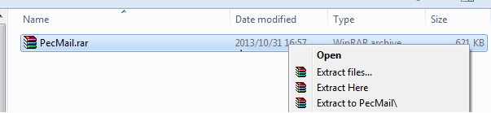
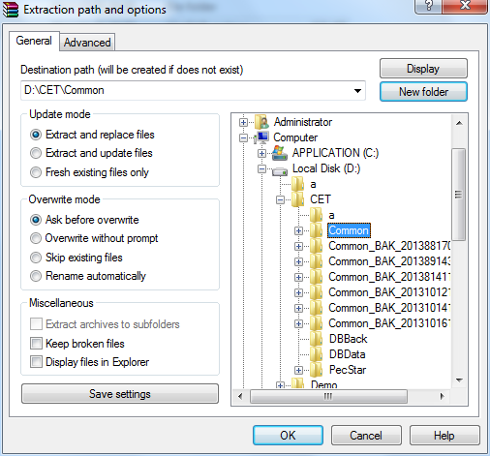
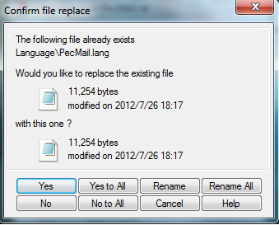
SOP for Configuring Auto-mail Report
Extract PecMail.rar to the PecStar installation directory(Default D:\CET\Common)
If the Confirm file replace textbox pops up, press Yes to All.

Slide 3
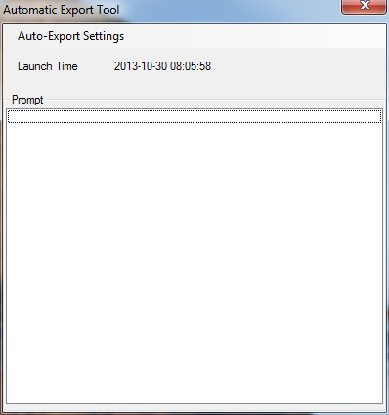
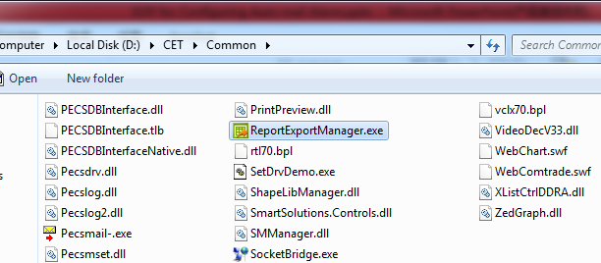
SOP for Configuring Auto-mail Report
Open the PecStar installation directory(Default: D:\CET\Common), open ReportExportManager.exe.

Slide 4
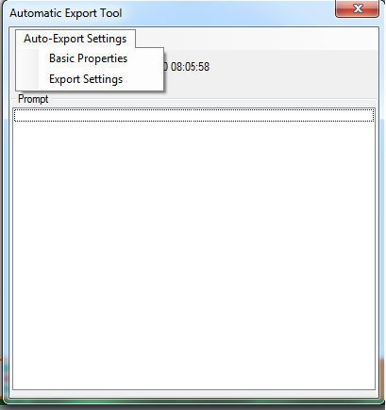
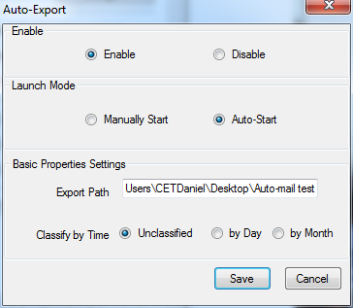
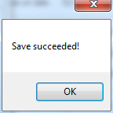
SOP for Configuring Auto-mail Report
Choose Basic Properties first. Set as below:
Enable: Enable.
Launch Mode: Auto-Start.(Auto Mode means the program will auto-startup when log in the operating system)
Export Path: Set as you want.
Classify by time: Unclassified.
Then press Save.

Slide 5
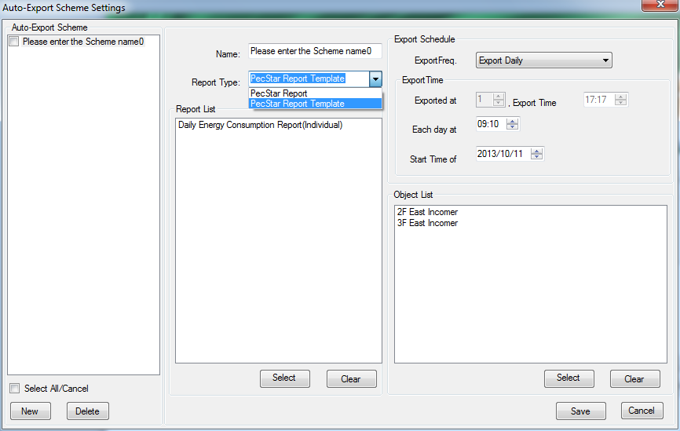
SOP for Configuring Auto-mail Report
Choose Export Settings.
Press New to build a Auto-Export Scheme.
Name: As you want.
Report Type: PecStar Report/PecStar Report Template. For PecStar Report Template, the devices need to be chosen in the Object List.
Report List: Press Select to choose Reports and add them into Report list.
ExportFreq: Export Daily/Monthly.
Export Time: The time you export every day/month and the start date.
Object List: Press Select devices to add in the list and the exported data will be stored in separate Excel files of different devices. (Only available for PecStar Report Template type)
Take 3F East Incomer as example, the auto-export Excel file name will be 3F East Incomer-Daily Energy Consumption Report+ time stamp.xls
Press Save and keep the program as background program.

Slide 6
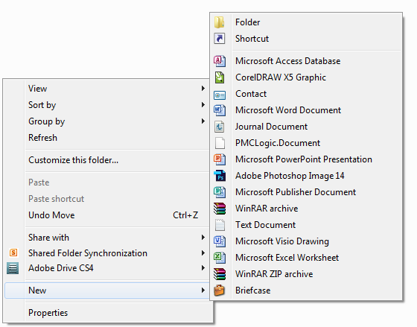
SOP for Configuring Auto-mail Report
Enter the export path of ReportExportManager.exe. (C:\Users\CETDaniel\Desktop\Auto-mail test)
Right click and choose New then choose Microsoft Excel worksheet and change the name. For example, the auto export report file name is 3F East Incomer-Daily Energy Consumption Report+ time stamp.xls, please set the file name as 3F East Incomer-Daily Energy Consumption Report.xls.
The no time stamp Excel file will be used in PecConfig to activate auto-mail function.

Slide 7
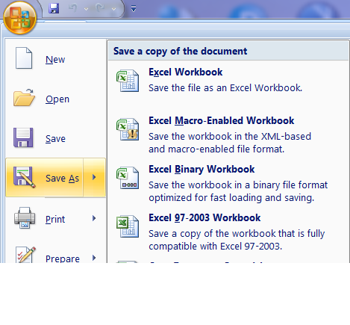
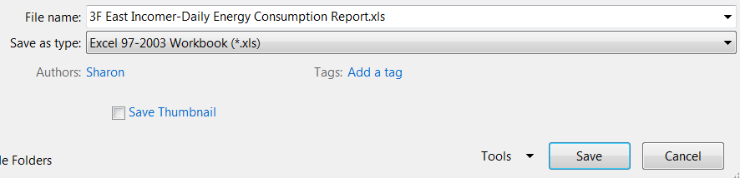
SOP for Configuring Auto-mail Report
If the new Excel file is .xlsx format, please change to .xls format (Excel 97-2003 Workbook format) in the following steps:
Open the xlsx file.
Choose Save As and choose Excel 97-2003 Workbook.
Change the name as the previous PPT.
Save the Excel file in the export path folder of ReportExportManager.exe.

Slide 8
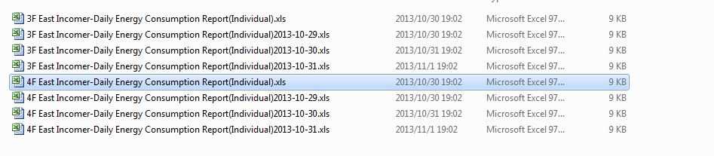
SOP for Configuring Auto-mail Report
The exported files with time stamp will be automatically stored in the export path folder.

Slide 9
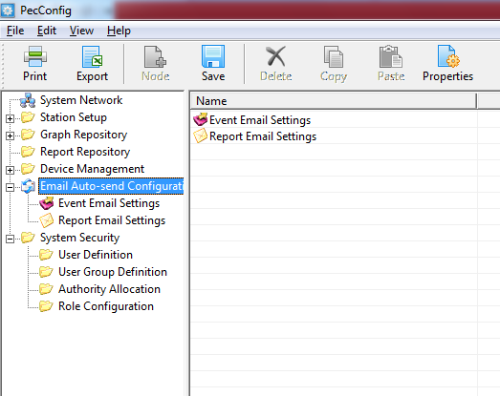
SOP for Configuring Auto-mail Report
Click Email Auto-send Configuration and press Properties.

Slide 10
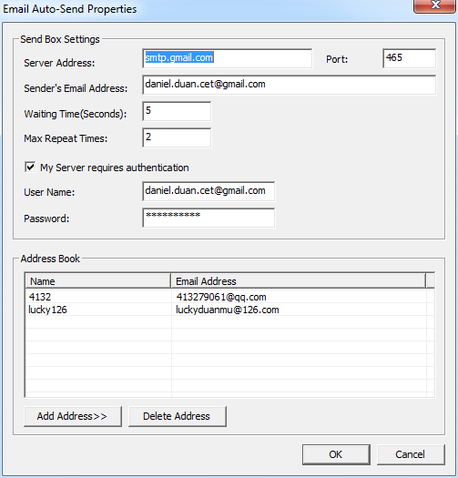
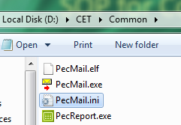
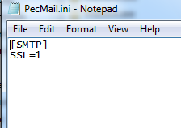
SOP for Configuring Auto-mail Report
Server Address and port number can be found in the mail service website.(For Gmail, please type server address: smtp.gmail.com and port: 465)
For SSL email account, open PecMail.ini in PecStar installation directory and change to SSL=1. For non-SSL account, change to SSL=0.
Type in Port number, Sender’s Email Address, Waiting Time and Max Repeat Time.
Check My Server requires authentication and type in User Name and Password.
Press Add Address>> and type in Name and Email Address to add in Address Book.
Press OK.

Slide 11
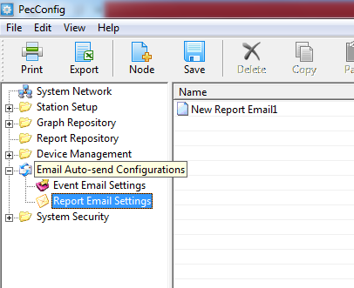
SOP for Configuring Auto-mail Report
Click Report Email Settings and press Add Node.

Slide 12
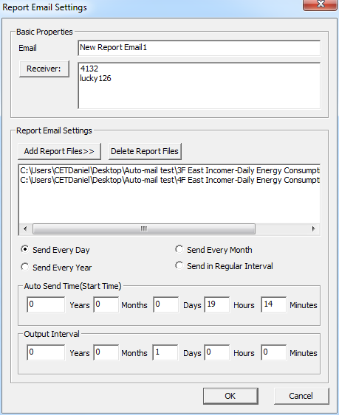
SOP for Configuring Auto-mail Report
Email is the Title of the sending email.
Receiver is the email address in the address book.
Report Email Settings: Press Add Report Files to add the auto-sending Excel file. Please add the no time stamp Excel file to the list. (e.g.: 3F East Incomer-Daily Energy Consumption Report.xls )
The program will automatically search the latest time stamp files in the folder as attachments.
Set the interval time as send every day/month/ year/regular interval.
Set Auto send time(Start time) and Output Interval. The email will auto-send by the Start time you set.

Slide 13
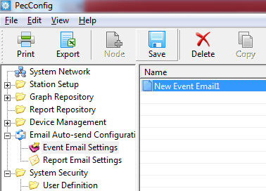
SOP for Configuring Auto-mail Report
After all the above configuration done, press Save.

Slide 14
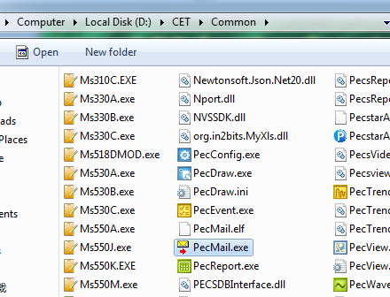
SOP for Configuring Auto-mail Report
Open Pecmail.exe in the PecStar installation directory
(Default: \CET\Common\Pecsmail.exe)
NOTE: If any auto-mail setting changed, please close PecMail.exe and restart it.

Slide 15
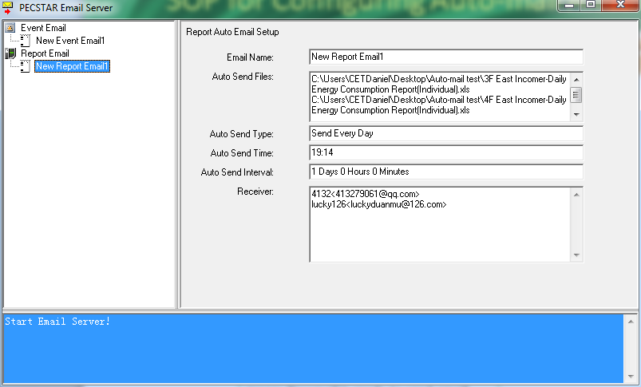
SOP for Configuring Auto-mail Report
The Email details are shown in the panel.
Start Email Server! in Pecsmail panel means Pecmail is ready to send email.

Slide 16

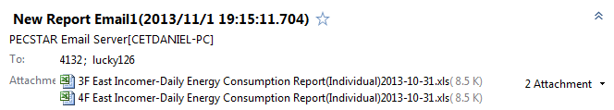
SOP for Configuring Auto-mail Report
The message of successfully sending report email shows up in Pecsmail panel as well.
The email and attachments can be received in a few seconds.

Slide 17
SOP for Configuring Auto-mail Report
Thank you!!!

